Slide 1


The Missing 80%
Dr. JT Kostman

Slide 2
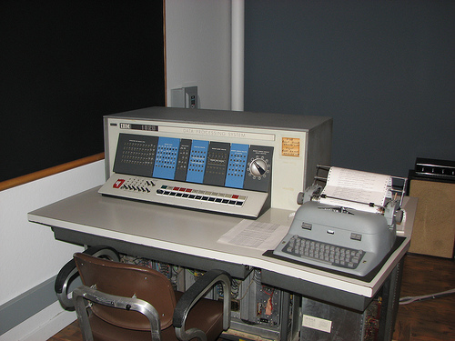
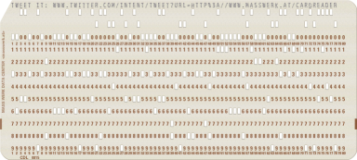
Up to 60,000 Digits!
0.007MB

Slide 3
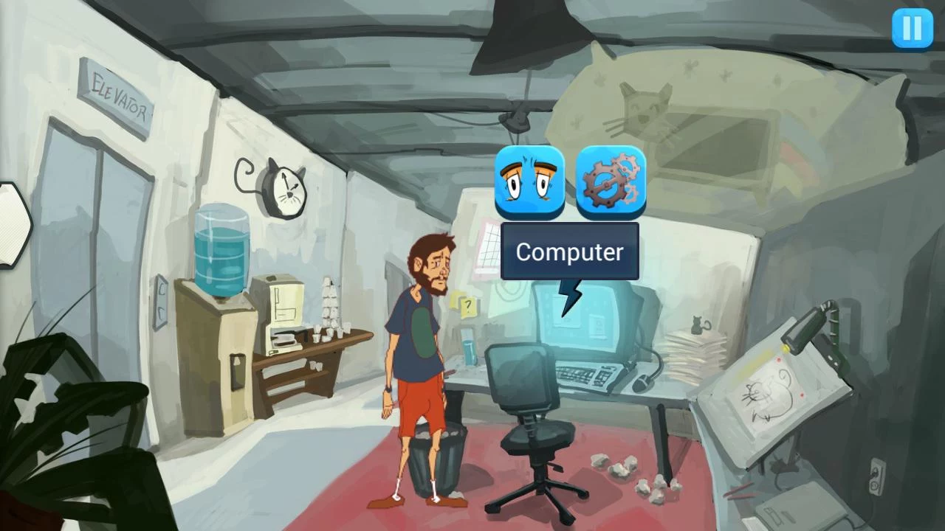

Slide 4
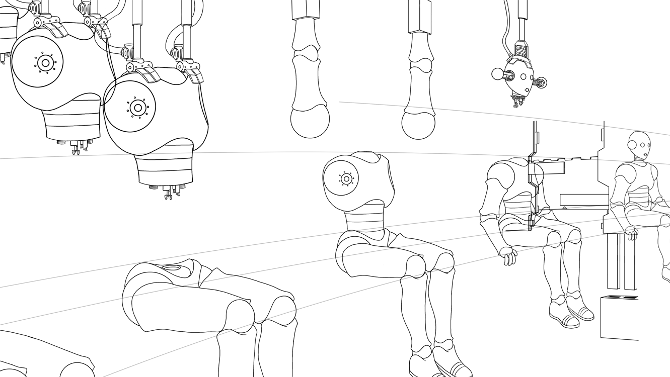

Slide 5

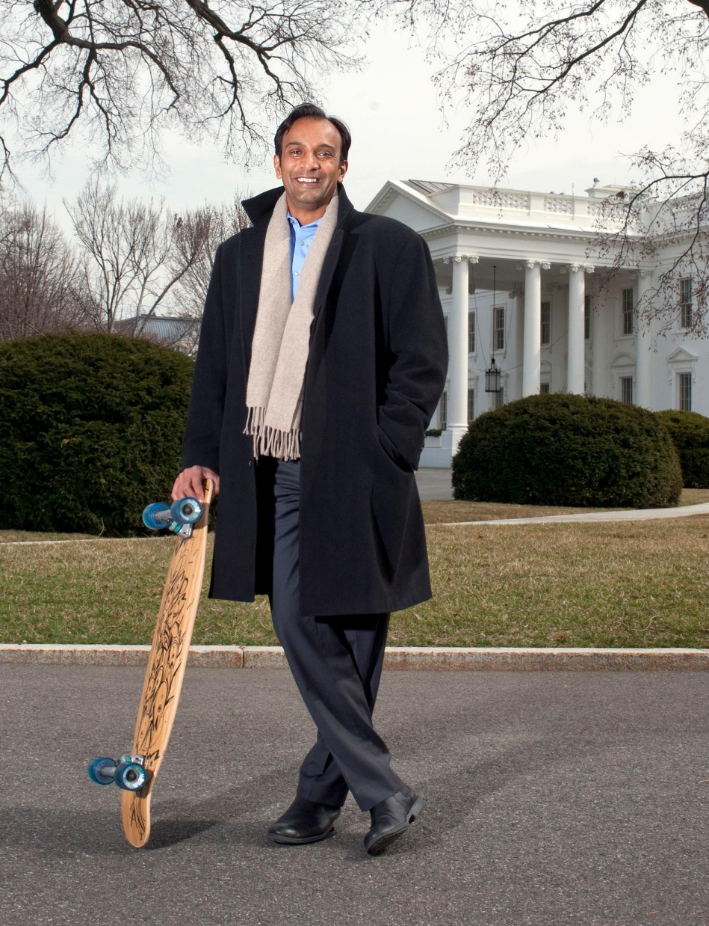
Data Scientist: The Sexiest Job of the 21st Century
Harvard Business Review (October 2012)

Slide 6
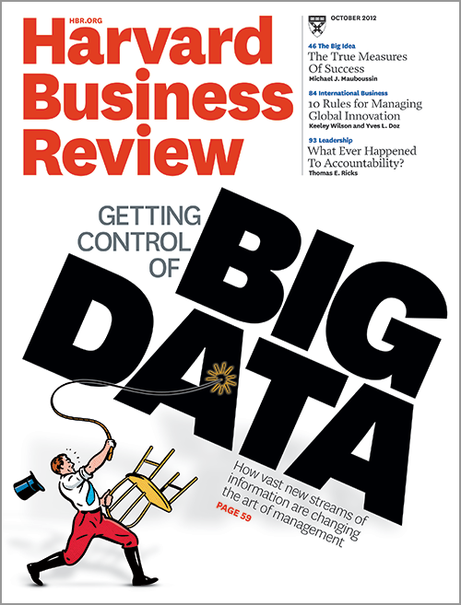
Data Scientist: The Sexiest Job of the 21st Century

Slide 7
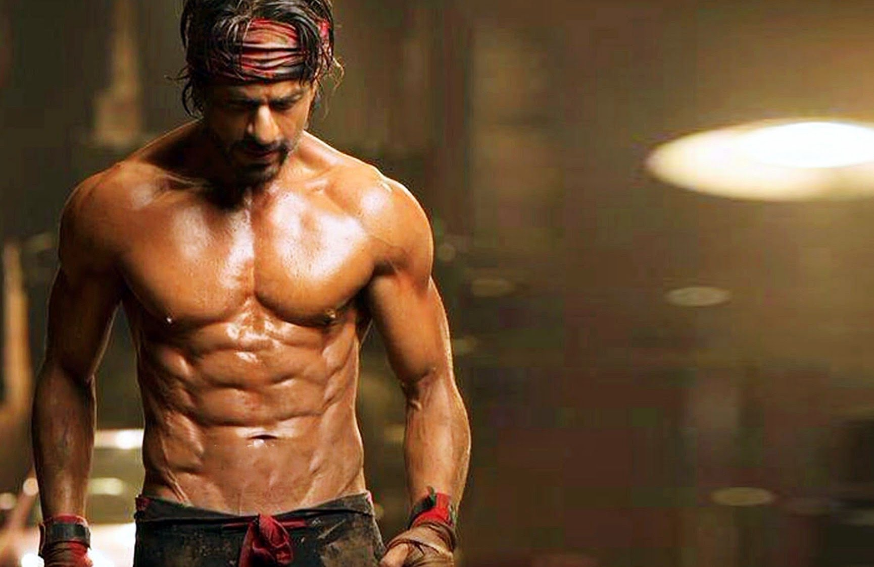
Shah Rukh Khan
Data Scientist

Slide 8
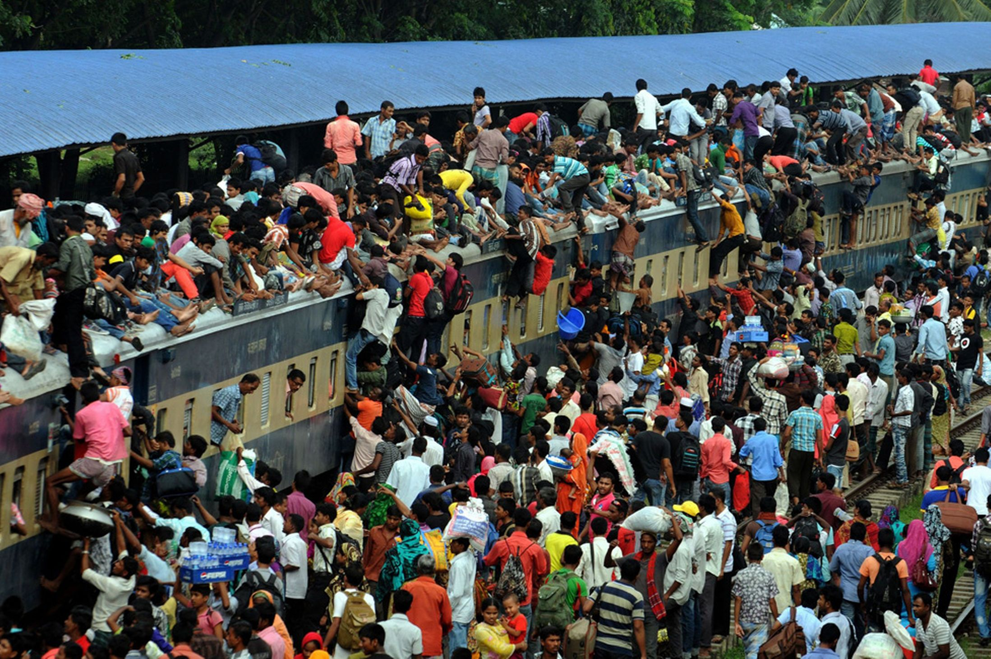
Data
Scientist

Slide 9


Slide 10


Slide 11
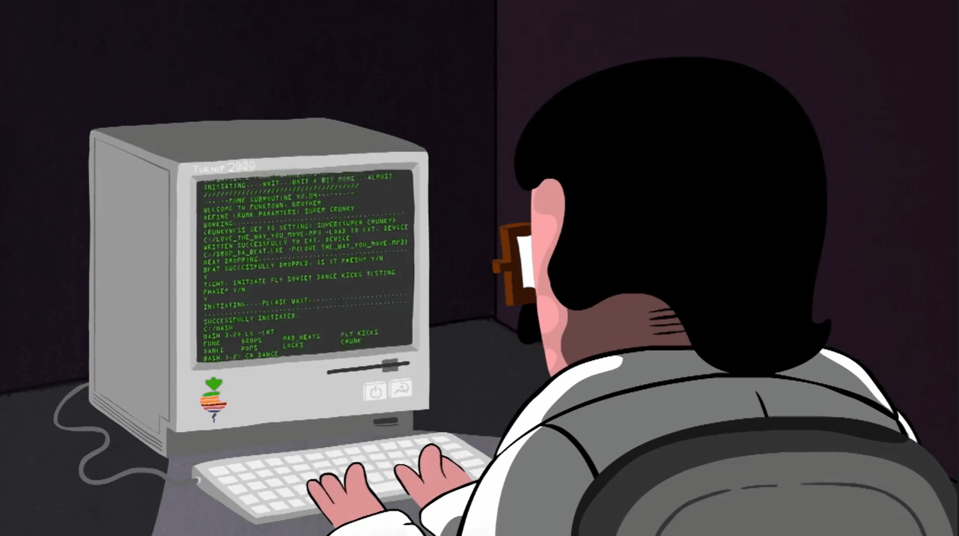
Data Technician

Slide 12


Slide 13
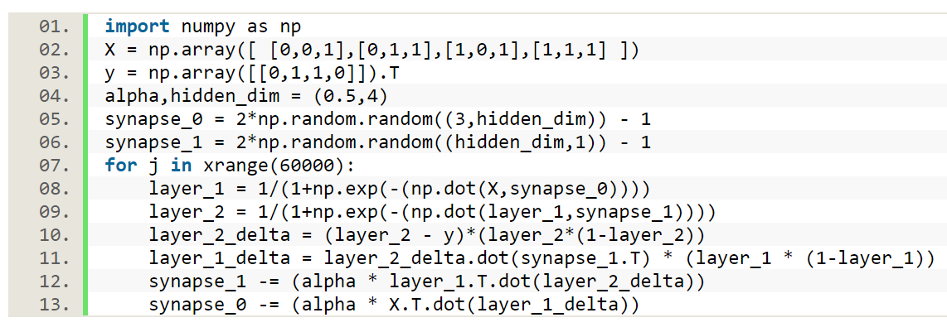
A Neural Network in 13 lines of Python

Slide 14


Slide 15
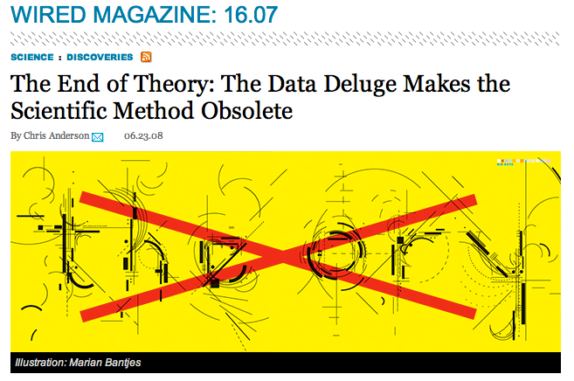

Slide 16
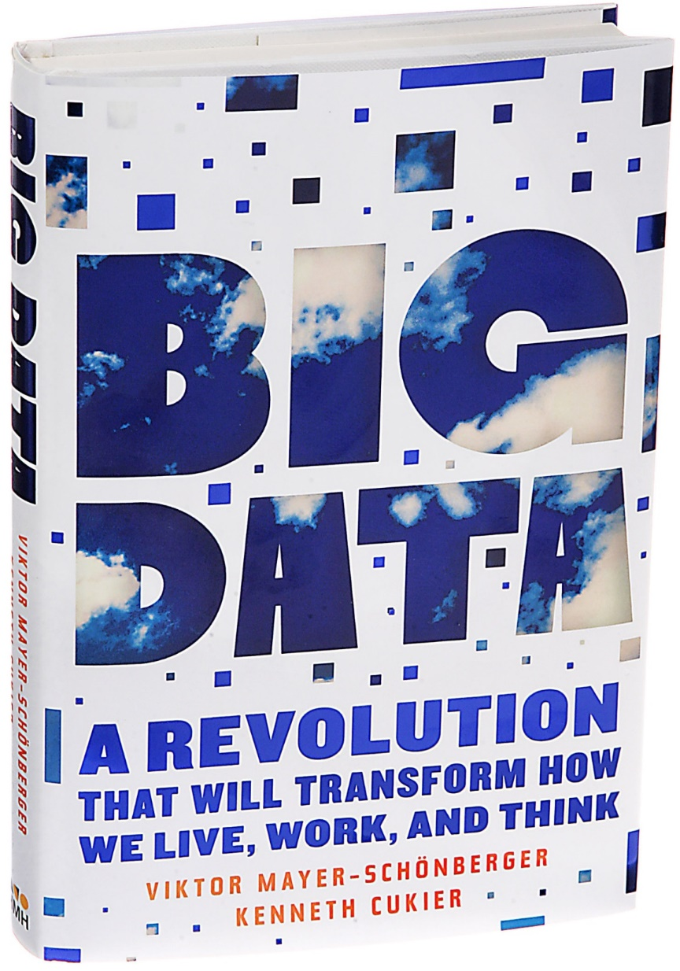
“…society will need to shed some of its obsession for causality in exchange for simple correlations: not knowing why but only what.”

Slide 17
“This overturns centuries of established practice and challenges our basic understanding of how to make decisions and comprehend reality.”

Slide 18
“Just as the telescope enabled us to comprehend the universe and the microscope allowed us to understand germs, the new techniques for collecting and analyzing huge bodies of data will help us make sense of our world in ways we are just starting to appreciate.”

Slide 19
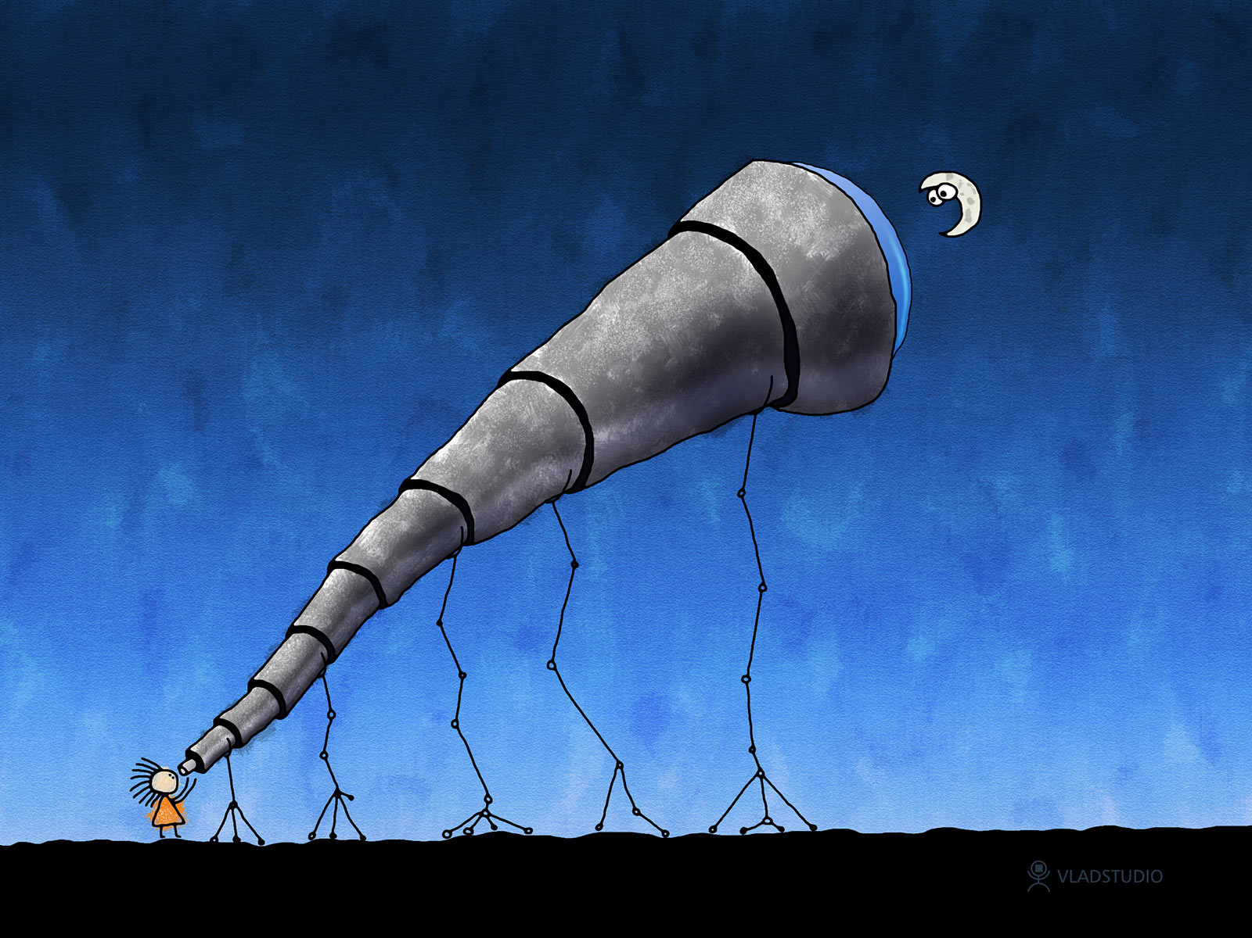

Slide 20

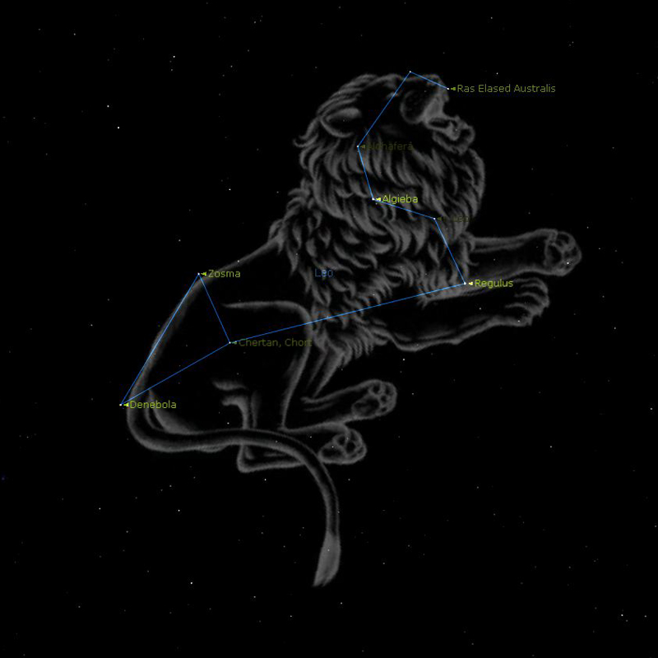

Slide 21

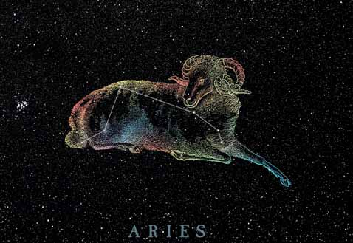
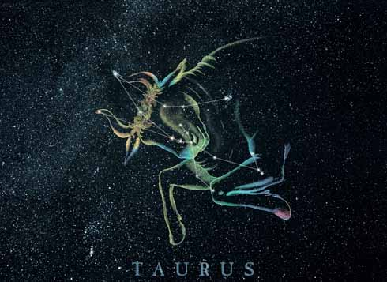


Slide 22
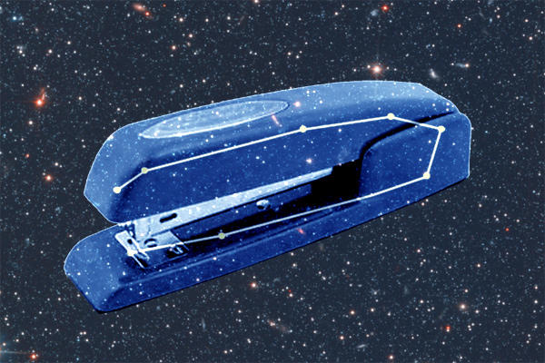

Slide 23
Pareidolia

Slide 24
The Scientific Method
Ask a Question
Do Background Research
Construct a Hypothesis
Test Your Hypothesis by Doing an Experiment
Analyze Your Data and Draw a Conclusion
Communicate Your Results

Slide 25
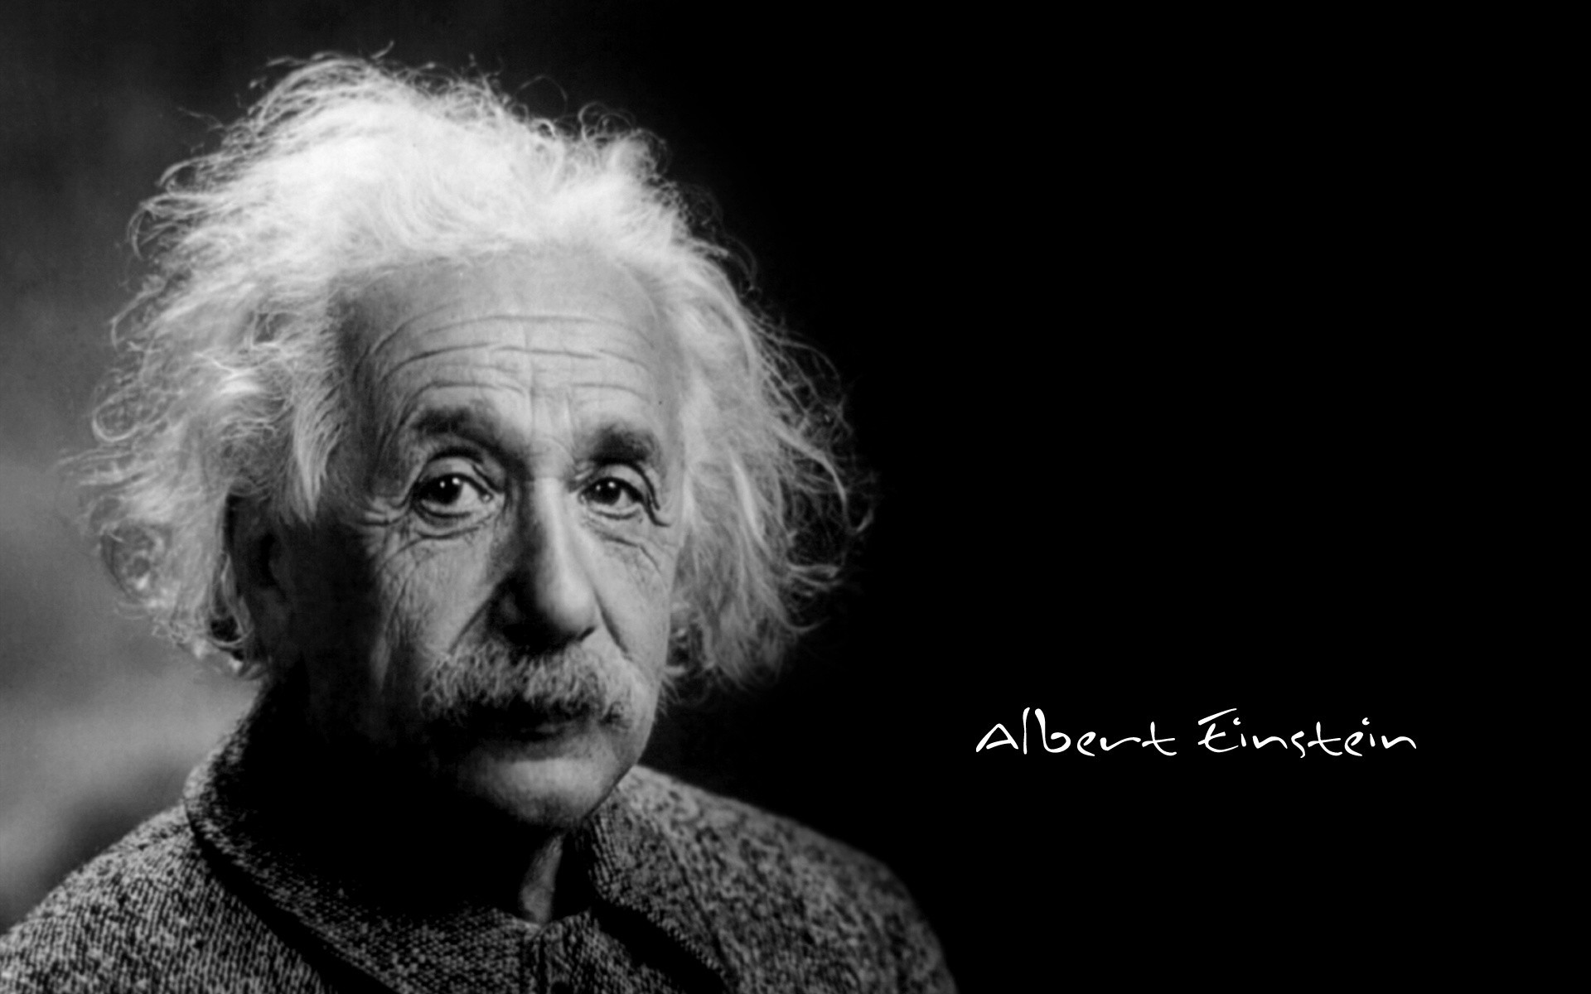
If I had only one hour to save the world, I would spend the first fifty-five minutes defining the problem.

Slide 26
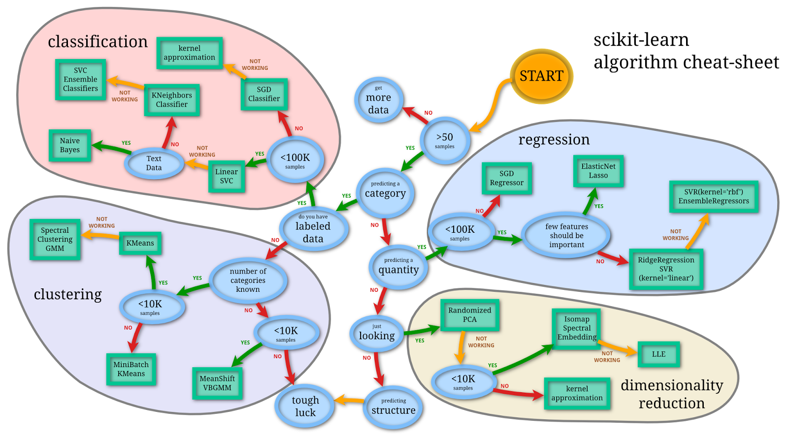
Analysis
Preparation
Presentation

Slide 27
The Right Question
The Right Data
The Right Methodology
Preparation

Slide 28
Defining The Problem
JT’s Rule: The question the client is asking is almost never the question that really needs to be answered
Ask yourself:
What is the situation or condition?
What are the consequences and/or costs?
Can we do something with the results?
Descriptive, Predictive, Prescriptive
Notes:
4.2

Slide 29
Research Question (DV ID)
Variable Identification (IV ID)
Preprocessing (Cleaning)
Missing Data
Normalization/Standardization
Outlier Identification
Central Tendency / Distribution / Variance / Range / Skewness / Heteroscedasticity
Transformation (e.g., Logarithmic)
Data Dictionary (Explication)
Metadata
Data Appends
Data Intimacy
Hypothesis Formation
Experimental Design
Analytic Approach (Boxes, Circles, Lines)
Preparation

Slide 30
Quid Tum
So What?

Slide 31
Quid Tum
What you are researching
I am investigating the topic of….
What your client doesn’t know
Because it will be important to know…
Why it is important they know
So that we can….
Notes:
3.4

Slide 32
You do not really understand something unless you can explain it to your grandmother.

Slide 33
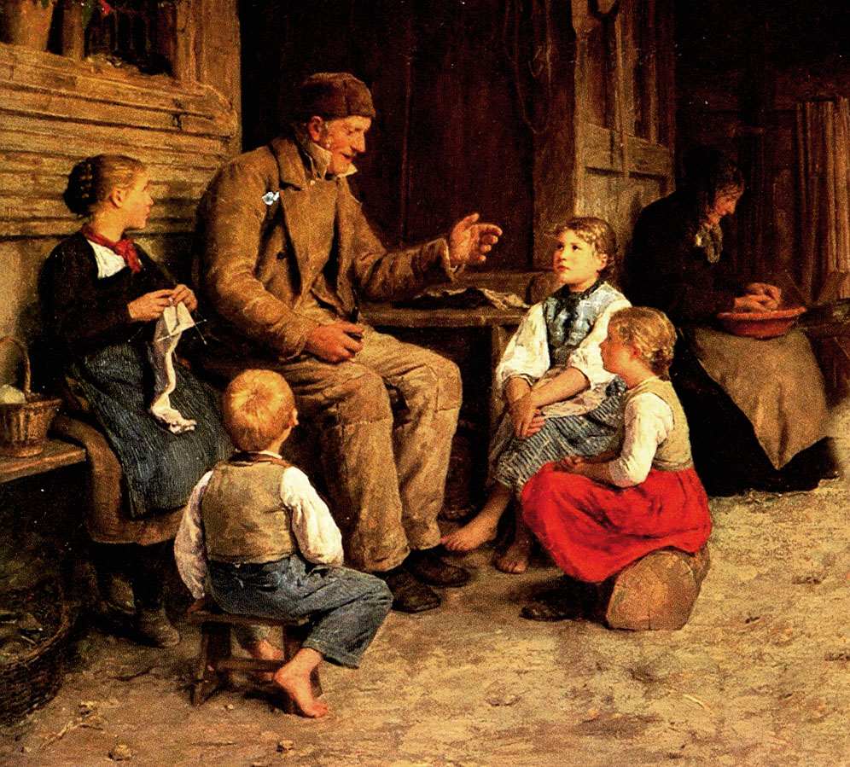
Presentation

Slide 34
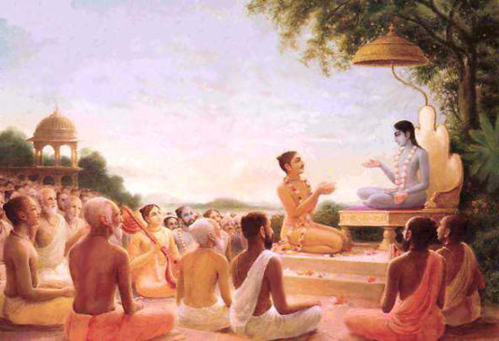
Upanishads
Notes:
The oldest and wisest story telling culture in the history of the world – from the Upanishads, to the Bhagavad Gita, to Bollywood – yours is a story telling culture

Slide 35
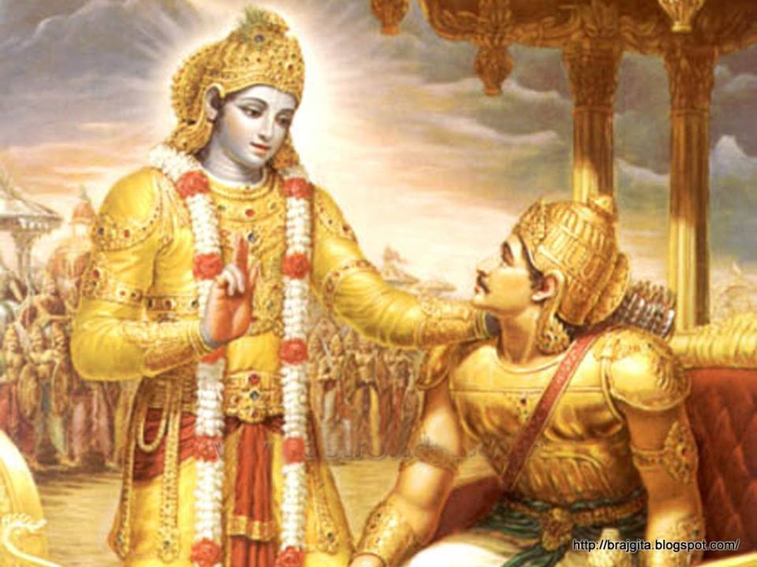
Notes:
The oldest and wisest story telling culture in the history of the world – from the Upanishads, to the Bhagavad Gita, to Bollywood – yours is a story telling culture

Slide 36


Slide 37
Upanishads
Sit Down Near
Shad = Sit
Ni = Down
Upa = Near
Notes:
The oldest and wisest story telling culture in the history of the world – from the Upanishads, to the Bhagavad Gita, to Bollywood – yours is a story telling culture

Slide 38
Quid Tum
Making a Cogent Argument
Conversation, Not Presentation
Support Your Claims
Anticipate Questions and Objections
Build a Pyramid (Minto)
Notes:
3.4

Slide 39
The Minto Pyramid
Answer
Reason
Reason
Reason
Proof
Proof
Proof
Proof
Proof
Proof
Proof
Proof
Proof
Notes:
https://medium.com/lessons-from-mckinsey/the-rule-of-3-c1cd82dbc96e

Slide 40
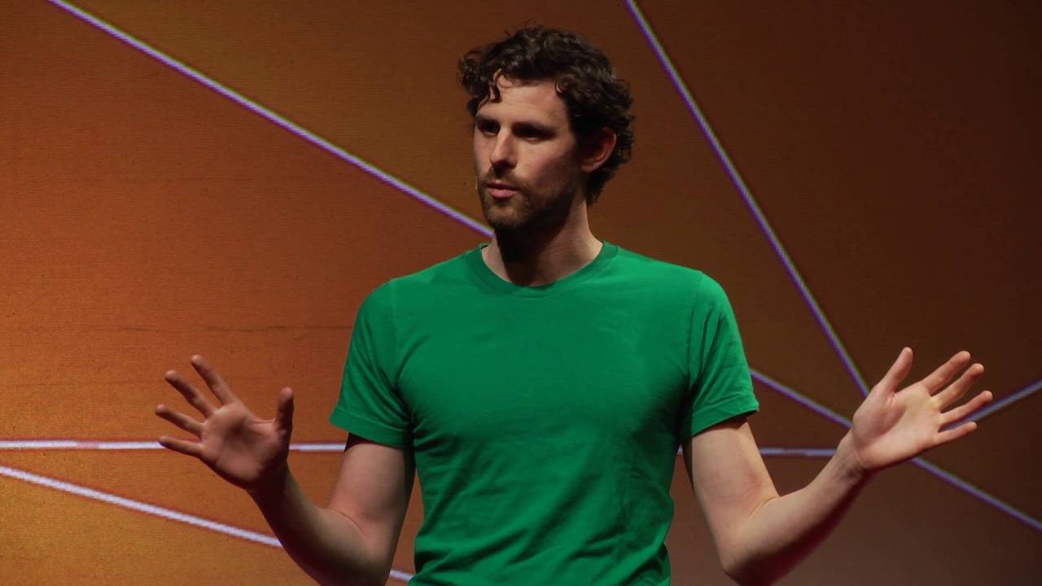
Dominic Walliman
Quantum Physics for 7 Year Old's

Slide 41
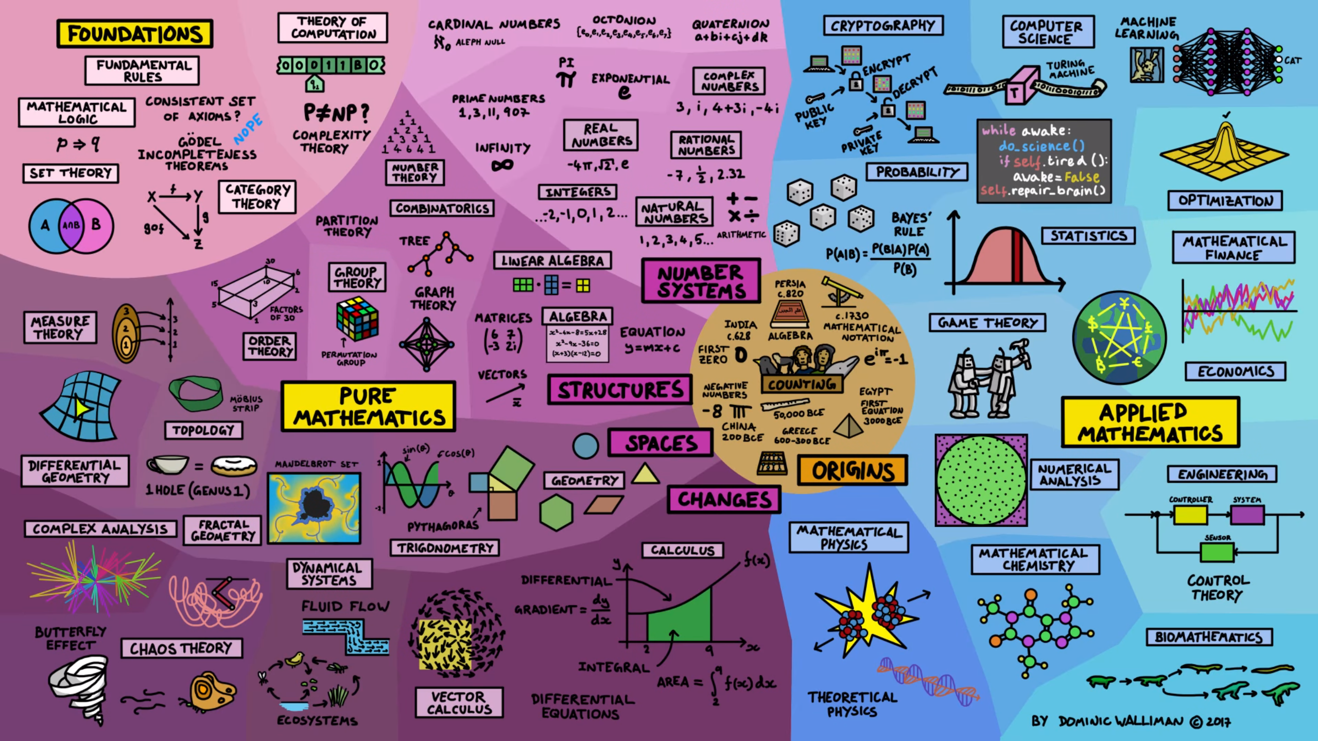

Slide 42
Dominic Walliman Rules for Explaining Science / Technology
Start off in the right place
Everyone has a different background or knowledge; start there.
Don’t go too far down the rabbit hole
Better to explain three things they will understand than a thousand things they won’t.
Clarity beats accuracy
Hard for us – but better a simpler explanation they can grasp than something they can’t.
Explain why you think it’s cool
If they get why you’re excited about it, or why it matters to them, they’ll remember it.

Slide 43
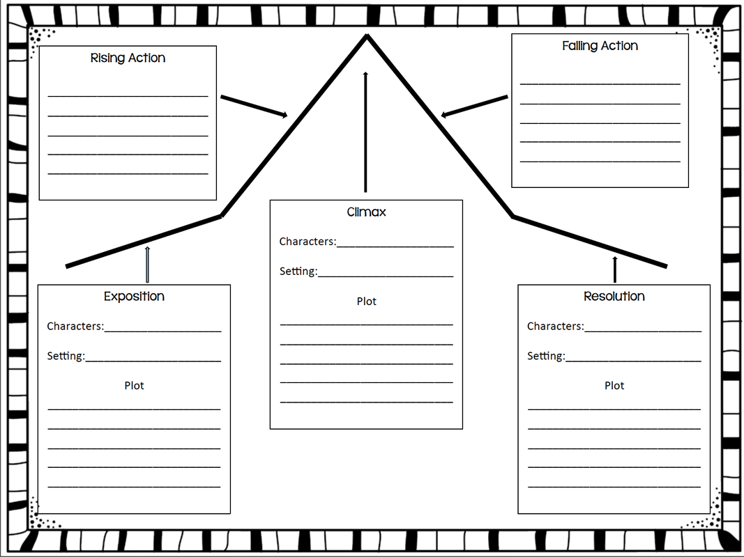

Slide 44
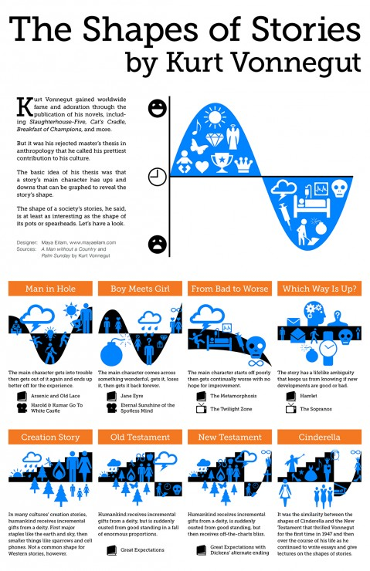
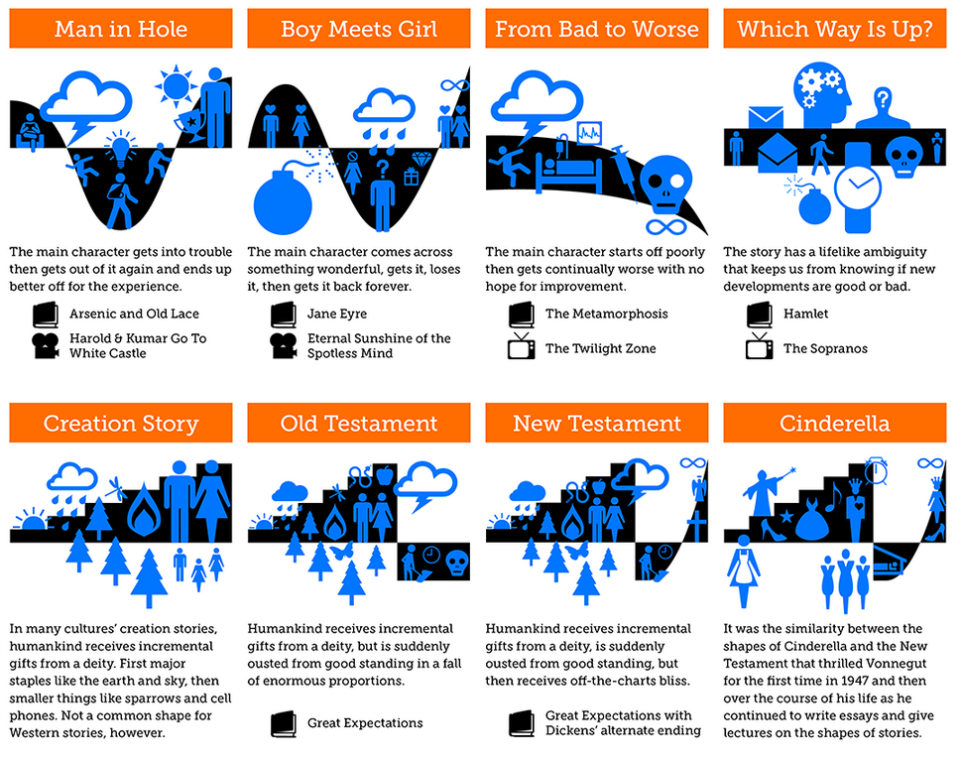

Slide 45

The Classic Data Story
Challenge
Complication
Consequence
Call to Action

Slide 46
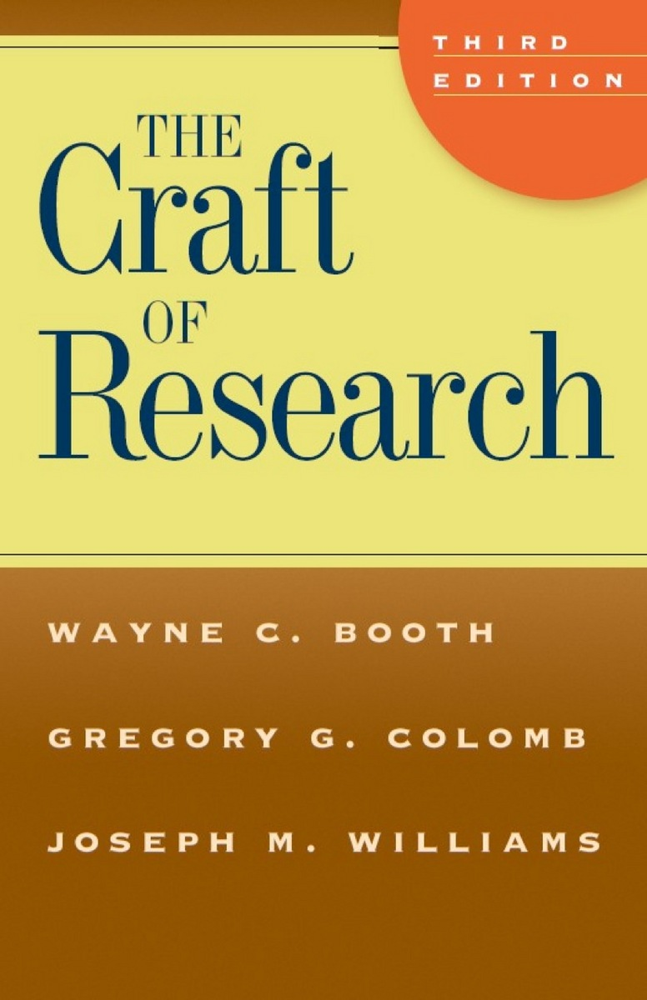


Slide 47
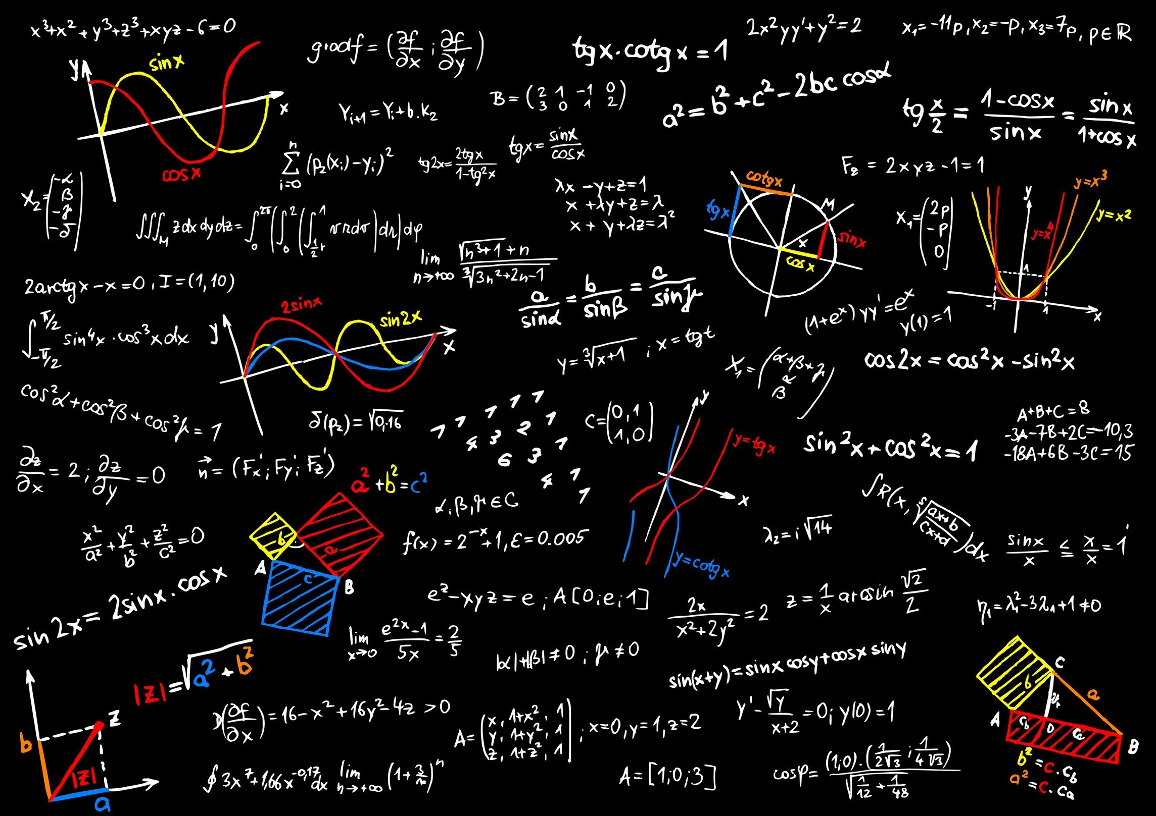

Slide 48


Slide 49
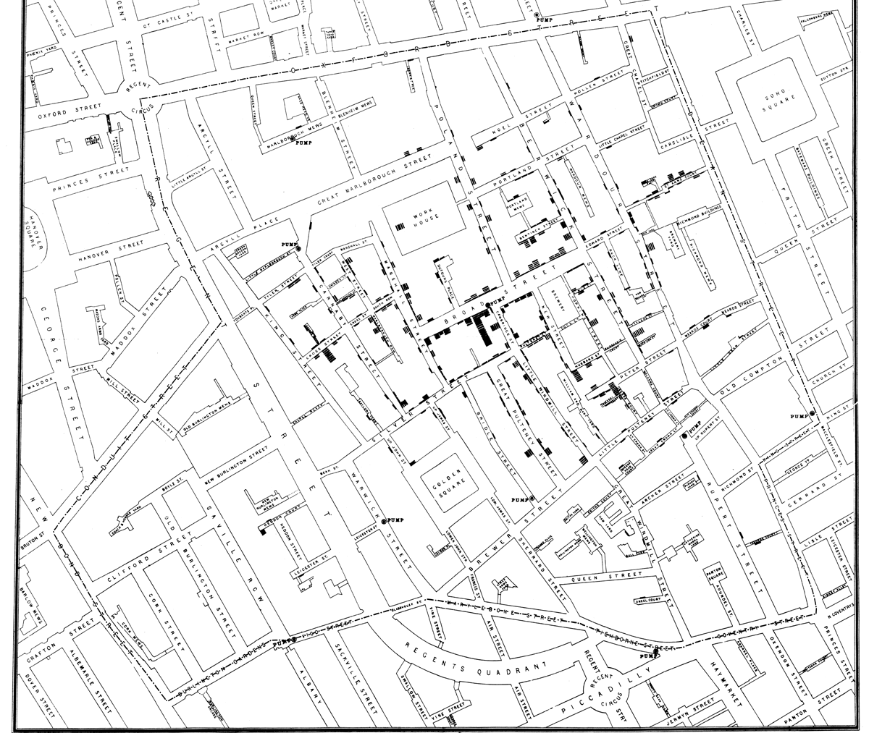
John Snow Cholera Map (1854)

Slide 50


Slide 51
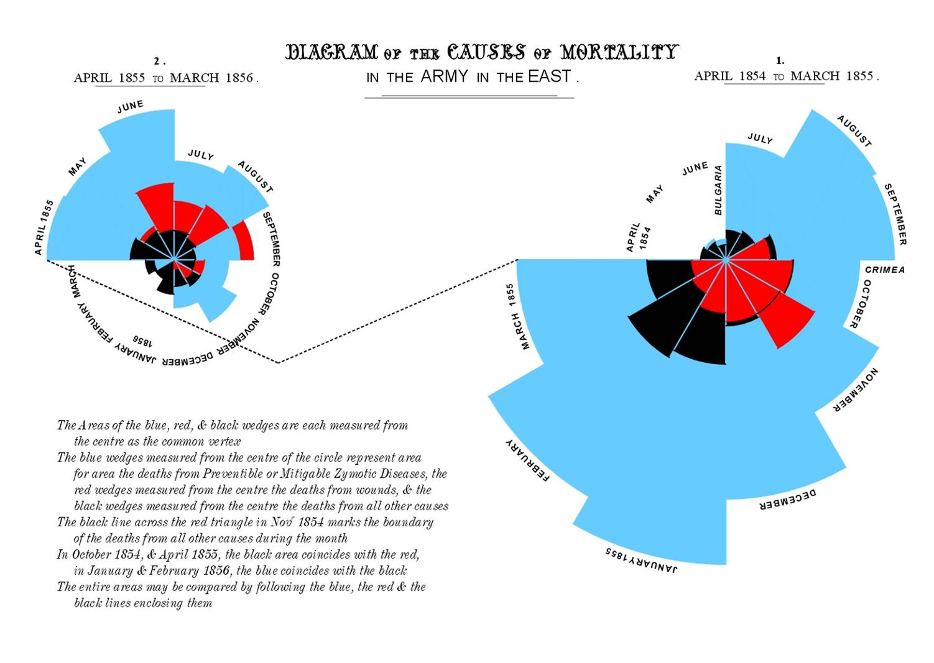

Slide 52
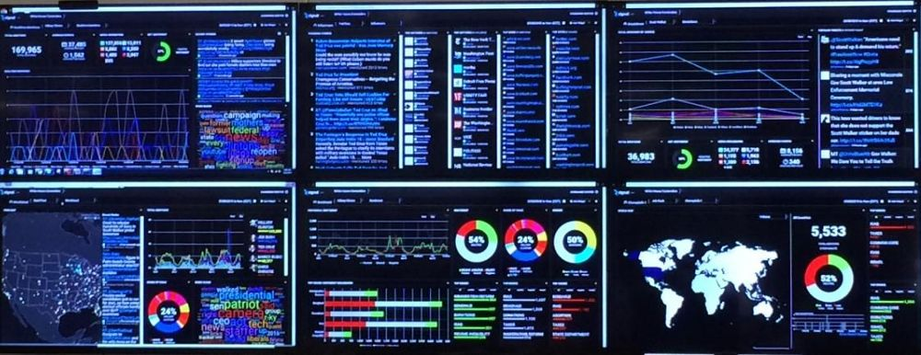

Slide 53
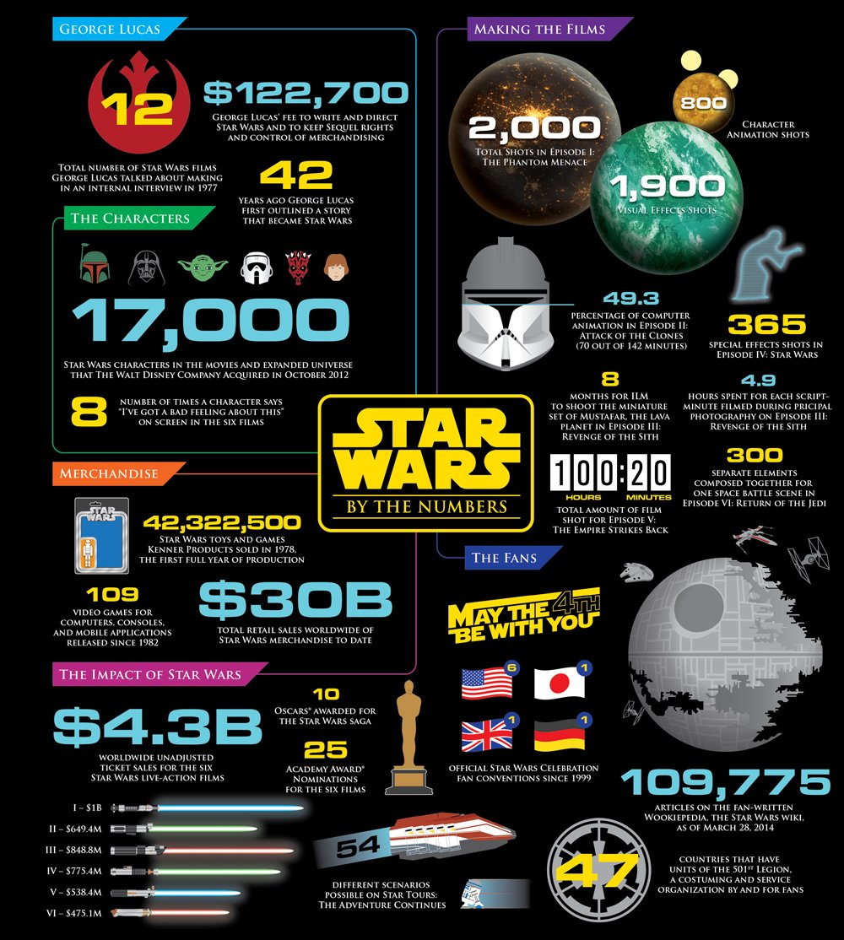

Slide 54
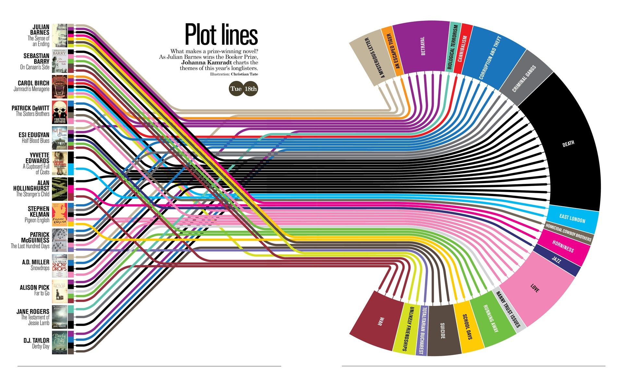

Slide 55
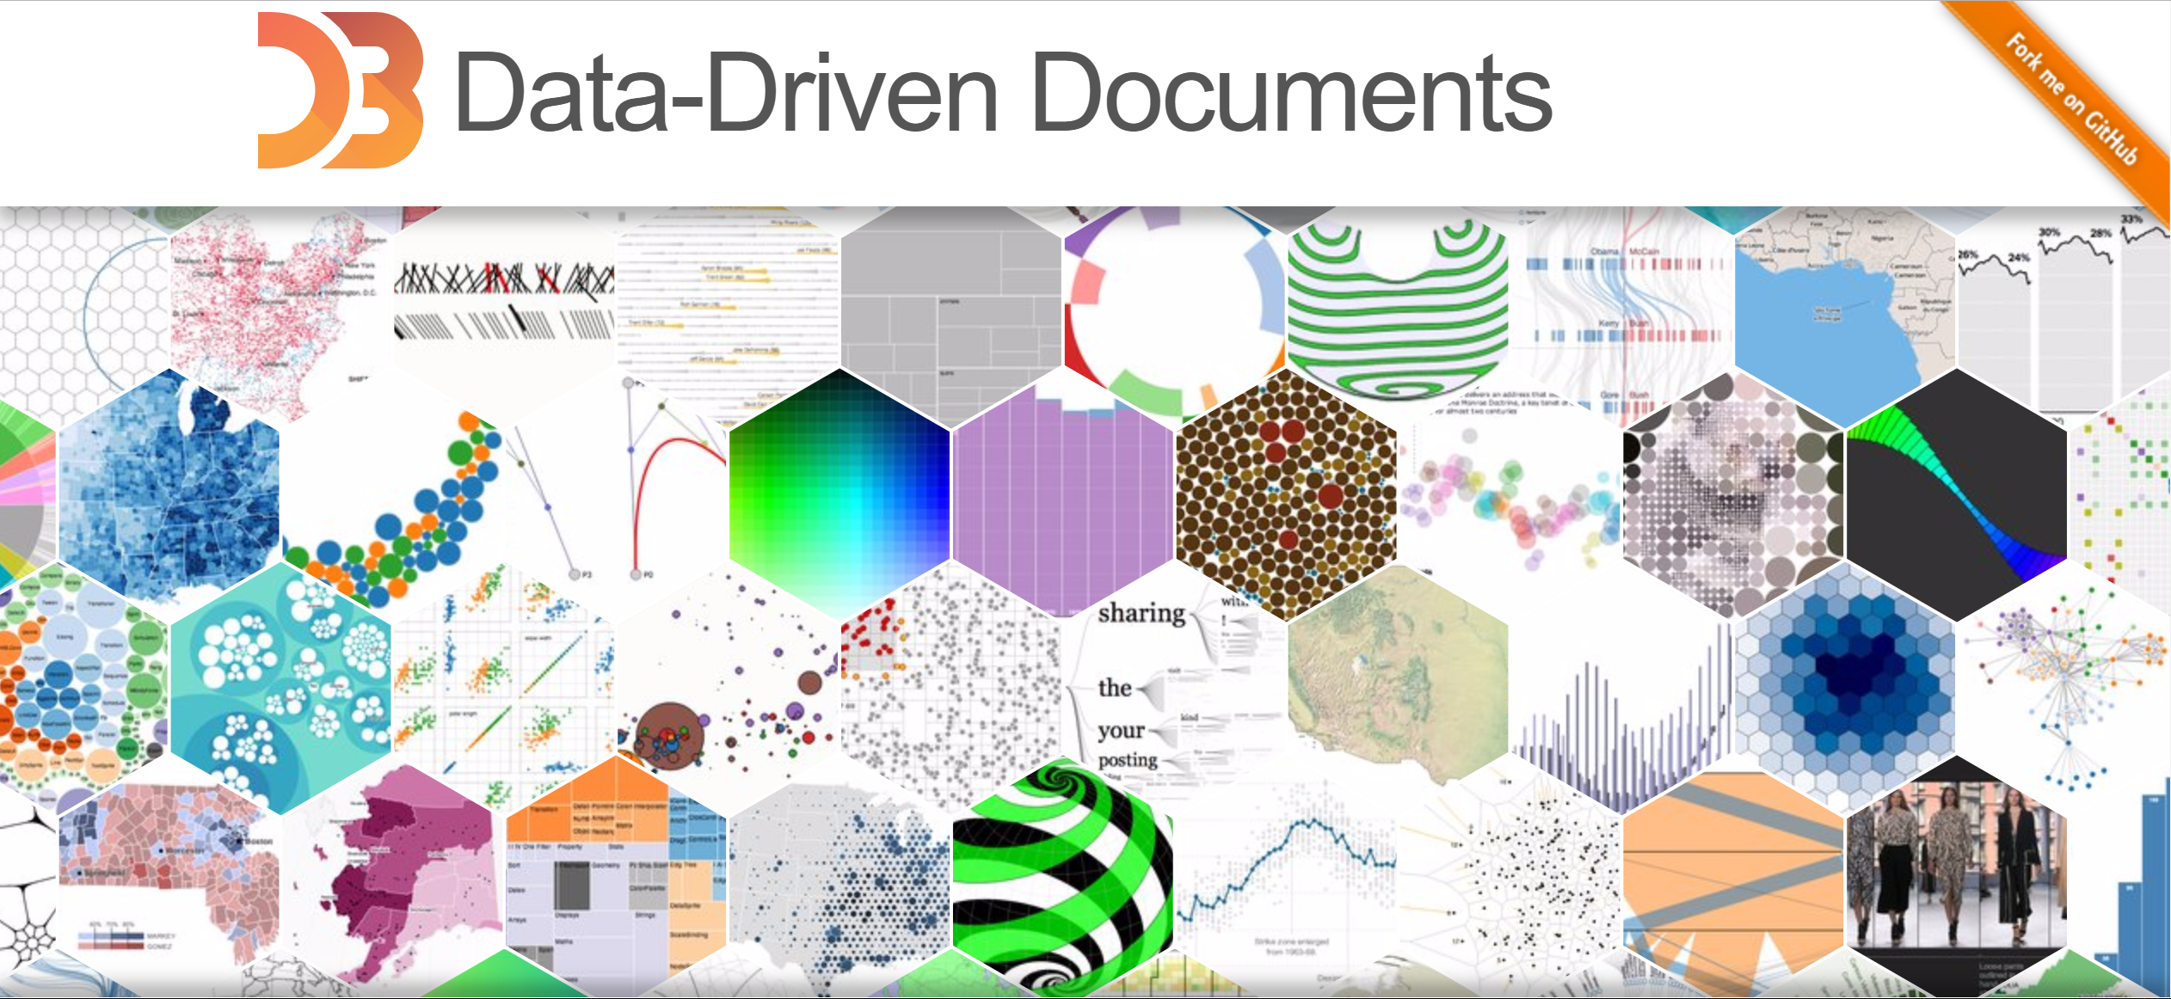
d3js.org

Slide 56
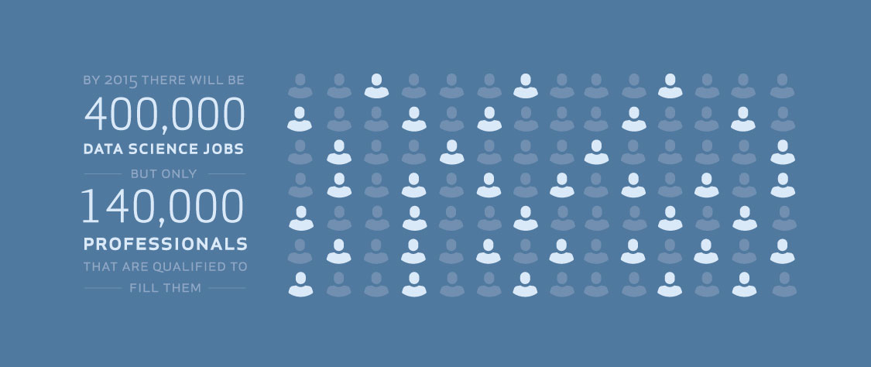
Notes:
Strata
DJ Pateel

Slide 58


Slide 59
Analysis
Thank You
Preparation
Presentation
धन्यवाद
Dr. JT Kostman

Slide 60
1729
Notes:
Hardy–Ramanujan number
"it is a very interesting number; it is the smallest number expressible as the sum of two cubes in two different ways."

